Slide 2






Arduino Programming

Slide 3

Hello!
I am Vishal Kalansooriya
Full stack Web Developer at Webnifix
Undergraduate Software Engineer at SLIIT Academy
You can find me @vishal.kalansooriya

Slide 4

1.
What is Arduino?
Let’s talk about Arduino…

Slide 5
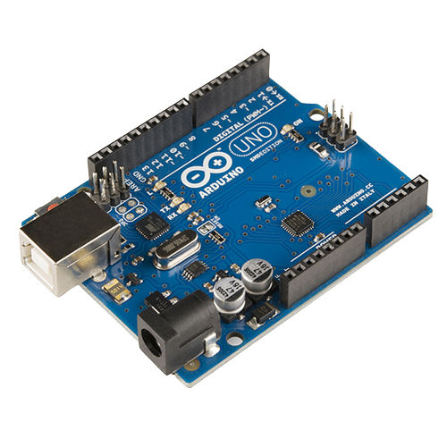
Arduino is an open-source electronics platform based on easy-to-use hardware and software.

Slide 6

2.
What is IoT?
Have you heard of the Internet of Things?

Slide 7


Slide 8
3.
Arduino Boards
Let’s see different types of Arduino boards…

Slide 9
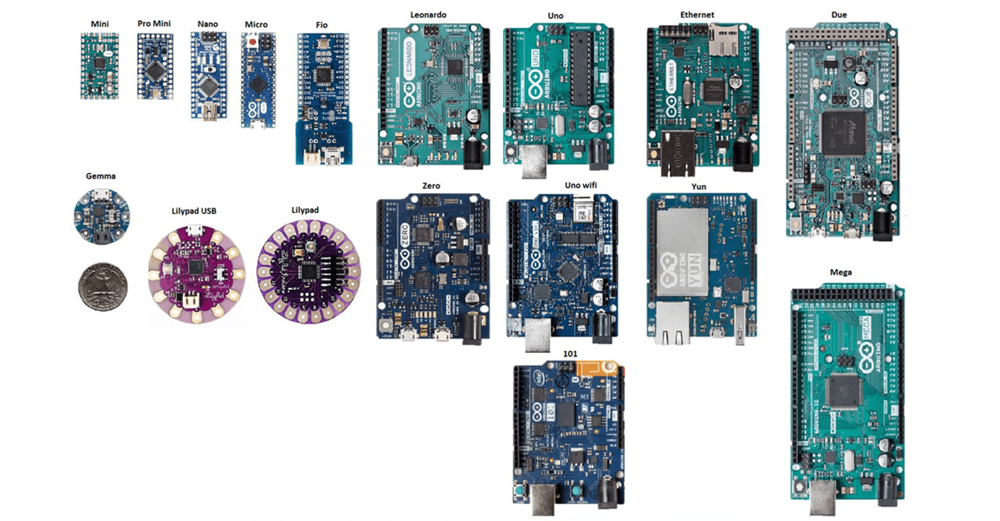

Slide 10
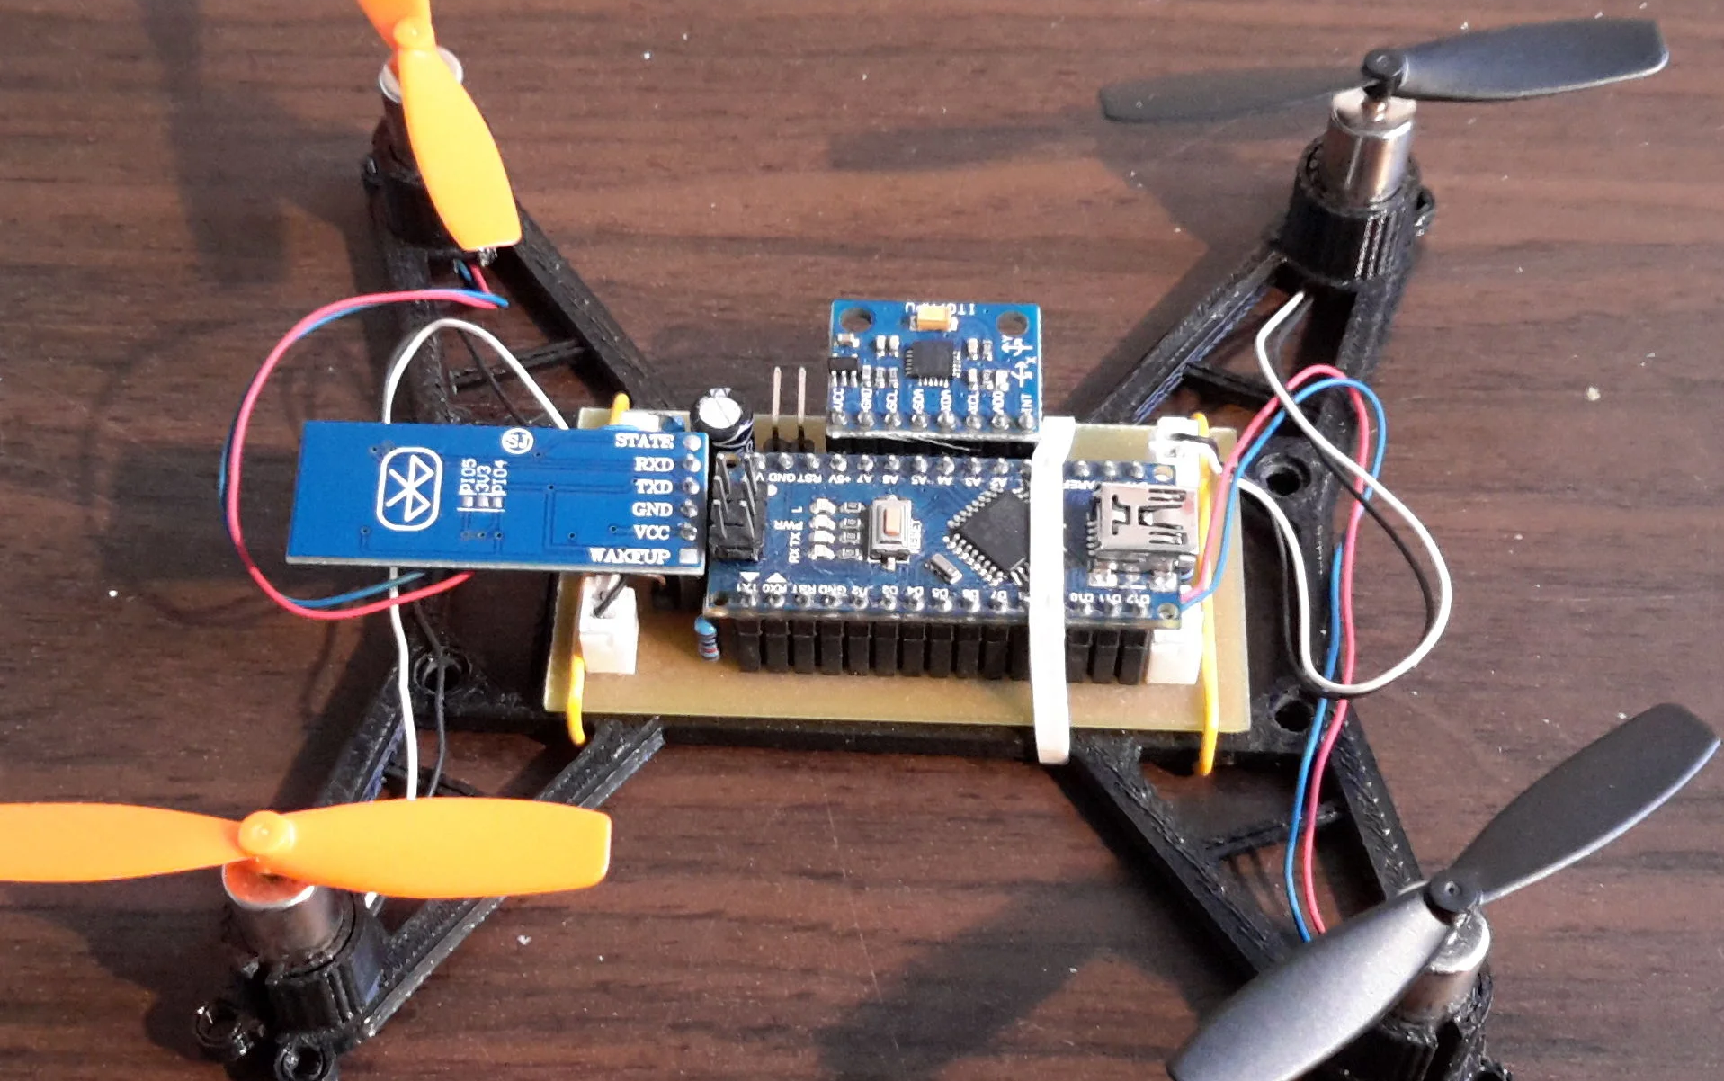
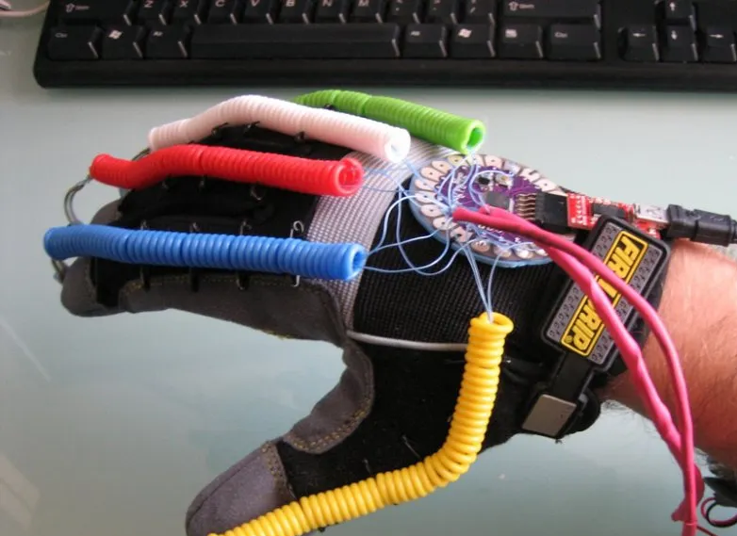
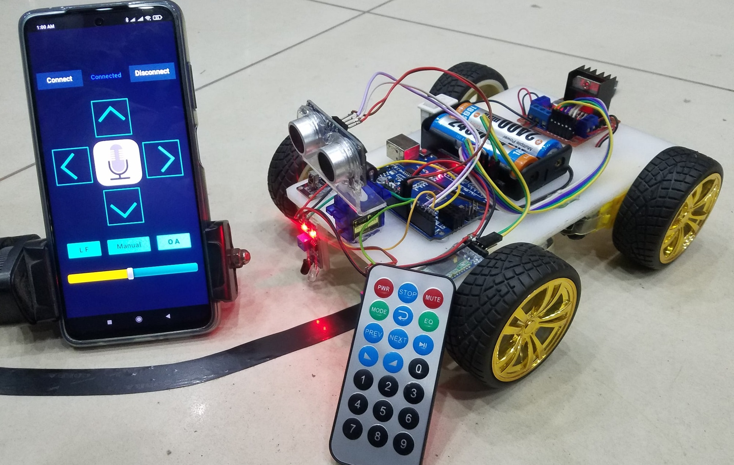
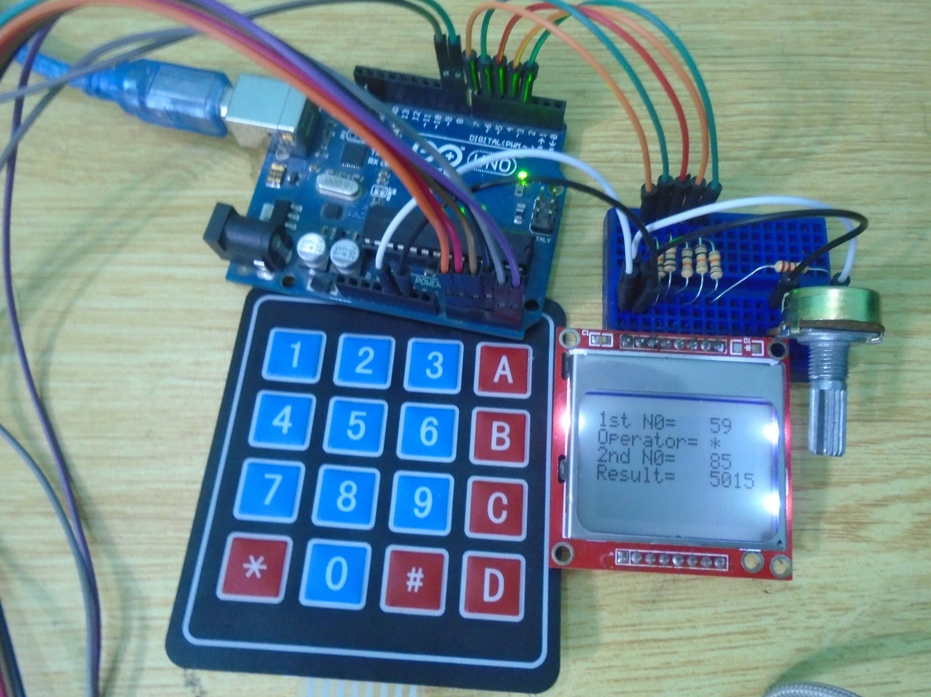

Slide 11
4.
Arduino UNO
Have you heard about the most popular Arduino board?

Slide 12
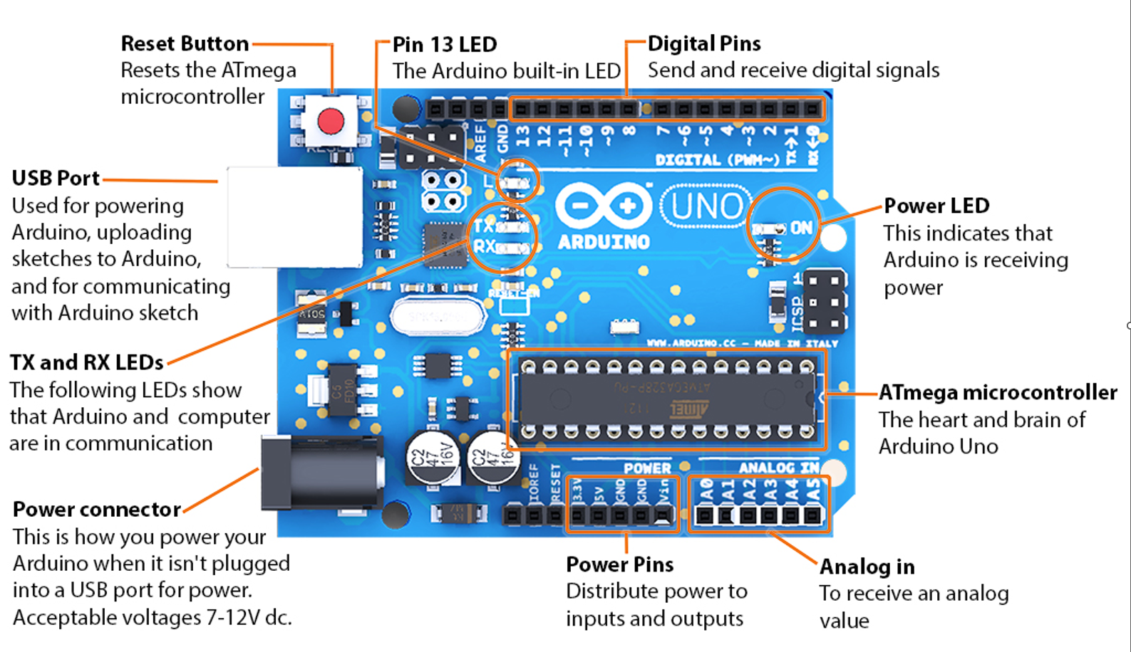

Slide 13
5.
Arduino IDE
Let’s have a look about the Arduino Integrated Development Environment.

Slide 14

Arduino IDE Installation
Visit https://www.arduino.cc/en/software to download Arduino Legacy IDE version.
Once you successfully install the Arduino IDE by running the setup file, launch the Arduino software by double clicking on the desktop shortcut.

Slide 15
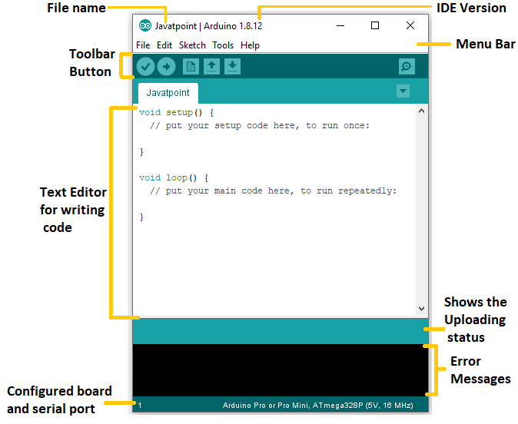
Arduino IDE
This is the place where you give commands to your Arduino board…

Slide 16
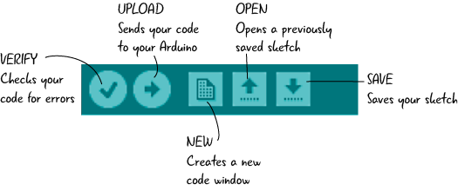
Toolbar Buttons

Slide 17
6.
setup() & loop() Functions
What are those default functions?

Slide 18
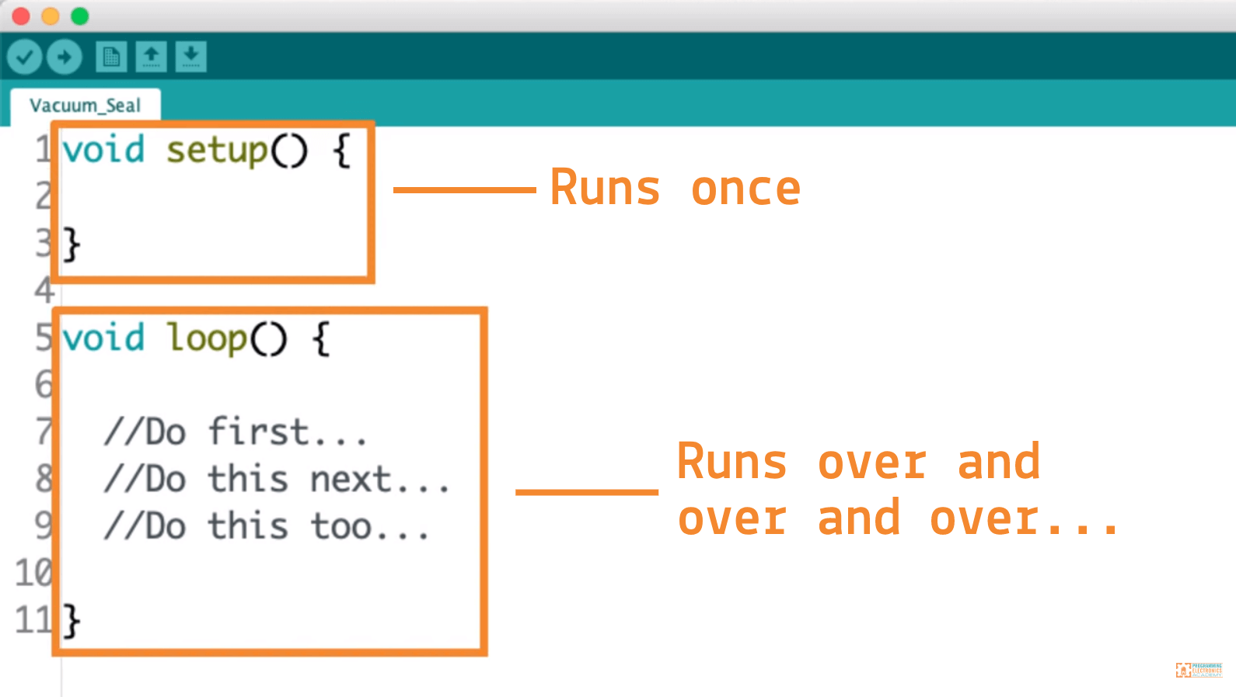
void setup() & void loop()

Slide 19

7.
Arduino Syntax & Program Flow
Let’s see Arduino programming language syntax and program flow…

Slide 20
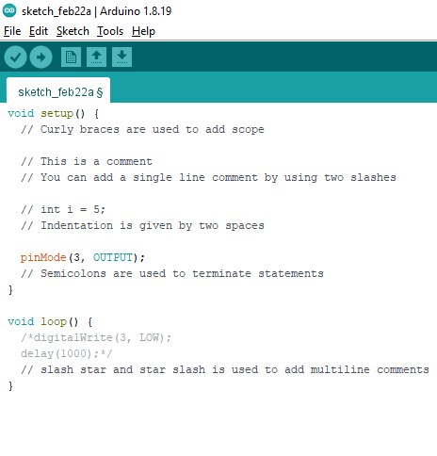
Curly Braces
Semicolon
Indentation
Comments

Slide 21
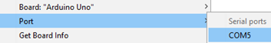
Configure Arduino Setup
Port:
Select the port that your Arduino is currently connected at.
Board:
Select your Arduino Board name from the available list.

Slide 22
7.
Other Function
Let’s walk through some other important functions…

Slide 23
pinMode() Function
Syntax | pinMode(pin, mode)
Parameters | pin: the Arduino pin number to set the mode of. mode: INPUT, OUTPUT, or INPUT_PULLUP.
Example | pinMode(5, OUTPUT); pinMode(6, INPUT);

Slide 24
digitalWrite() Function
Syntax | digitalWrite(pin, value)
Parameters | pin: the Arduino pin number. value: HIGH or LOW.
Example | digitalWrite(13, HIGH); digitalWrite(12, LOW);

Slide 25
delay() Function
Syntax | delay(ms)
Parameters | ms: the number of milliseconds to pause. Allowed data types: unsigned long.
Example | delay(1000); // waits for a second delay(1500); // waits for a second and a half

Slide 26
8.
Project 1 Blink a LED
Let’s build our first simple project

Slide 28
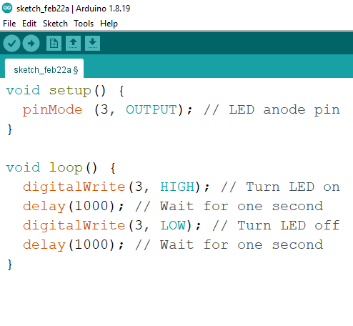
Pin Setup & Code
LED Anode | Digital pin 3
LED Cathode | GND

Slide 29
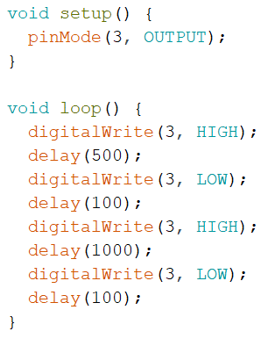
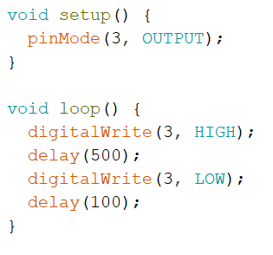
Similar Codes

Slide 30
9.
Project 2 Blink 3 LEDs
Let’s blink two more LEDs…

Slide 31
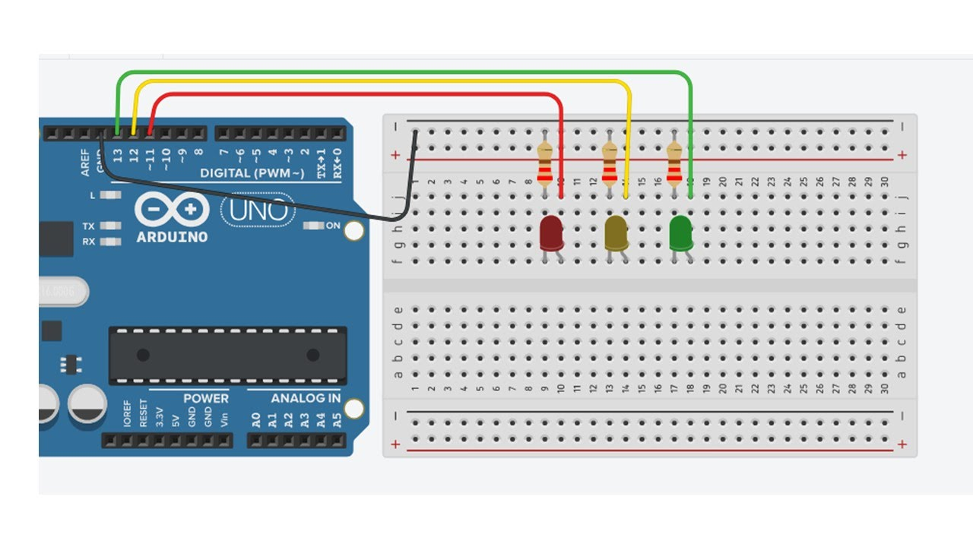

Slide 32
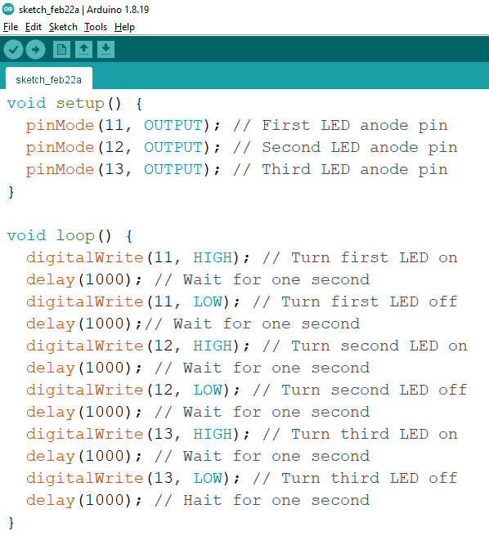
Pin Setup & Code
1st LED Anode | Digital pin 11
1st LED Cathode | GND
2nd LED Anode | Digital pin 12
2nd LED Cathode | GND
3rd LED Anode | Digital pin 13
3rd LED Cathode | GND

Slide 33
10.
Few Extra Functions
Would you like to learn more?

Slide 34
Serial.begin() Function
Syntax | Serial.begin(speed)
Parameters | speed: bits per second (Supported values are: 9600, 14400, 19200, 38400, 57600, 115200, 230400 bps.)
Example | Serial.begin(9600);

Slide 35
Serial.print() Function
Syntax | Serial.print(val)
Parameters | val: the value to print. (Allowed data types: any data type.)
Example | Serial.print(“Hello World”); Serial.print(“Hi ” + “there”);

Slide 36
Serial.println() Function
Syntax | Serial.println(val)
Parameters | val: the value to print. (Allowed data types: any data type.)
Example | Serial.println(“Hello”); Serial.println(“World”); Serial.println(“Programme”);

Slide 37


Thanks!
Any Questions?
Feel free to contact me at:
@vishal.kalansooriya
+94771130189
vishalkalansooriya@gmail.com
Visit https://github.com/vishal-kalansooriya/arduinoProgramming to get the lecture slides & other resources…

